Slide 1
Email Subject Line A/B Testing for E-commerce Campaigns
Analyzing the impact of Personalized vs. Urgency-based subject lines on Open Rate, CTR, and Conversions.

Slide 2
Project Overview
This project analyzes the impact of two subject line strategies: Personalized and Urgency-Based.
Key metrics: Open Rate , Click-Through Rate (CTR) , and
Conversion Rate.
Goal: Identify the most effective subject line strategy to engage users and drive conversions.

Slide 3
Problem Statement
Many e-commerce businesses face challenges with low engagement in email marketing.
Users often ignore or delete promotional emails without opening them.
This project investigates whether Personalized or Urgency-Based
subject lines perform better.

Slide 4
Subject Line Variants and Examples
1. Personalized Subject Lines
Tailored to the recipient's name, past behavior, or preferences.
Example: "John, your exclusive offer is waiting! 🎉"
Expected Outcome: Increased engagement by making the email feel relevant.
2. Urgency-Based Subject Lines
Creates a sense of urgency or scarcity.
Example: "Hurry! Your 50% discount expires in 3 hours! ⏳"
Expected Outcome: Drives immediate action due to FOMO (Fear of Missing Out).

Slide 5
Hypothesis Statement
Metric | Null Hypothesis (H₀) | Alternative Hypothesis (H₁)
Open Rate | There is no significant difference in open rates between variants. | Personalized subject lines result in higher open rates.
CTR (Click-Through Rate) | There is no significant difference in CTR between variants. | Urgency-based subject lines result in higher CTR.
Conversion Rate | There is no significant difference in conversion rates between variants. | Urgency-based subject lines result in higher conversion rates.

Slide 6

Metrics And Sample Size
Key Metrics:
Open Rate = (Emails Opened / Emails Sent) × 100%
CTR = (Clicks / Opened Emails) × 100%
Conversion Rate = (Purchases / Clicks) × 100%
Sample Sizes:
Total emails sent: $N=500,000$
Split evenly between groups:
$$N_{personalized}=250,000$$
$$N_{Urgency}=250,000$$

Slide 7
Email Performance Comparison by Subject Line Variants
Metric | Personalized (%) | Urgency (%) | Winner
Open Rate | 44.8 | 40.2 | 🟩 Personalized
CTR | 18.0 | 22.2 | 🟩 Urgency
Conversion Rate | 0.6 | 1.1 | 🟩 Urgency

Slide 8
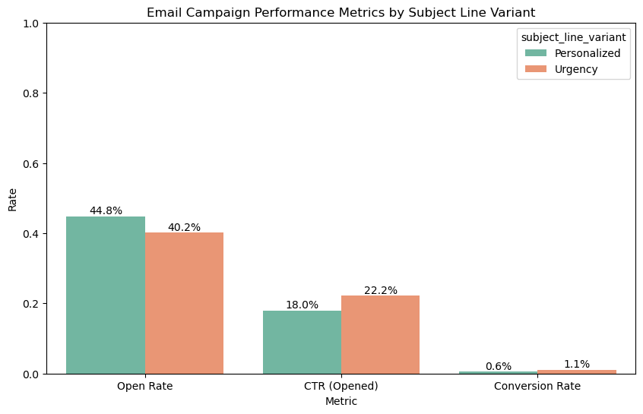

Slide 9
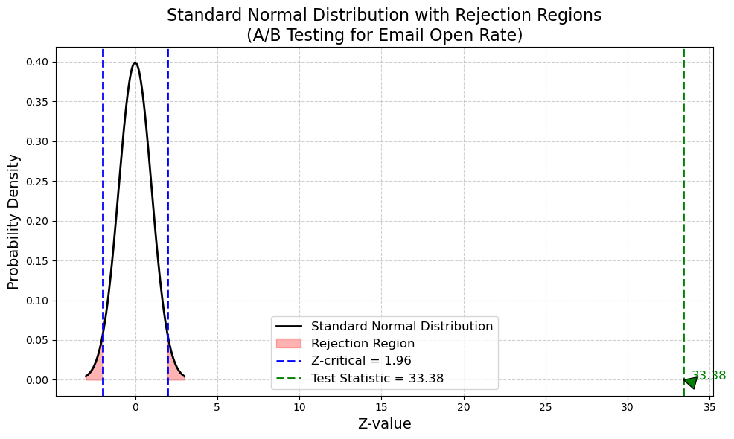
Statistical Significance – Open Rate
Z-score: 33.38
Interpretation: The Z-score is far beyond the critical threshold (±1.96).
The difference in open rates is
statistically significant.
Personalized subject lines are
significantly better for driving email
opens.

Slide 10
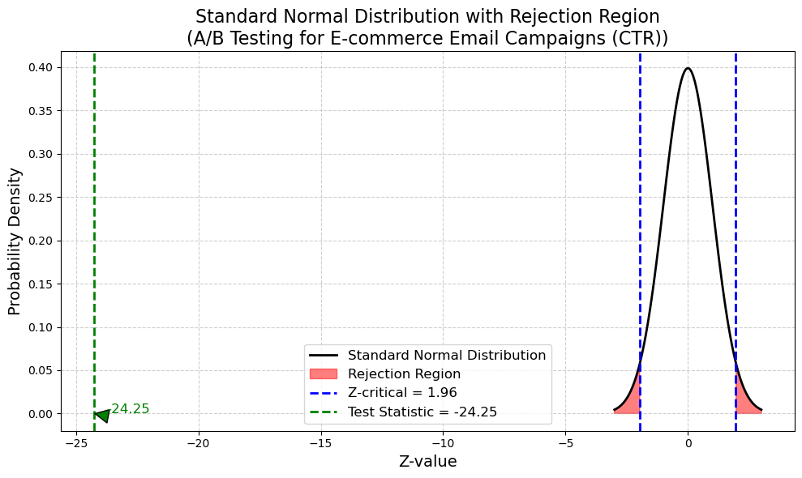
Statistical Significance – CTR
Z-score: -24.25
Interpretation: The Z-score is far
beyond the rejection region.
Urgency-based subject lines drive
significantly higher CTR.

Slide 11
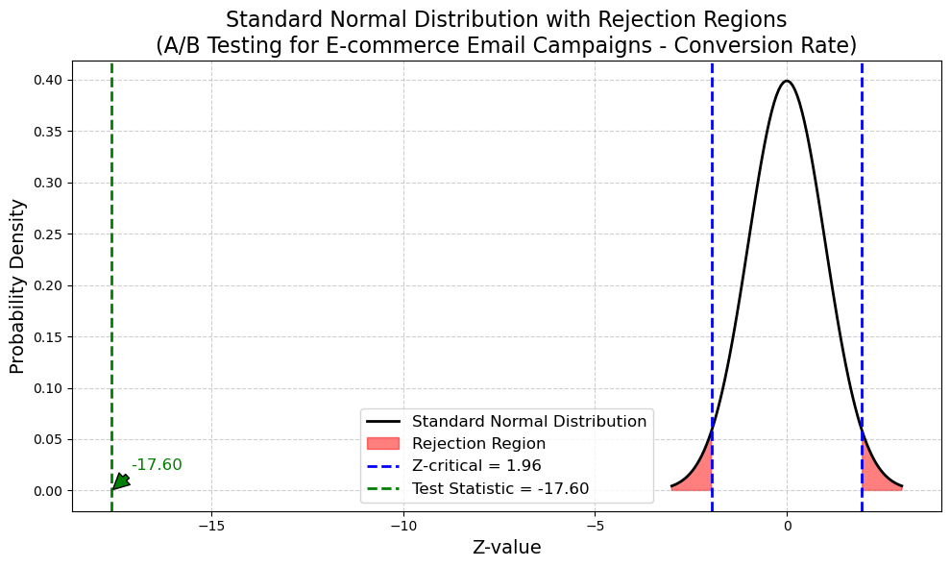
Statistical Significance – Conversion Rate
Z-score: -17.60
Interpretation: The Z-score is far
beyond the rejection region.
Urgency-based subject lines drive
significantly higher Conversions.

Slide 12
Key Insights
Personalized subject lines excel in Open Rates,
meaning users find them more engaging.
Urgency-based subject lines drive higher CTR
and conversions, leading to more sales.
Statistical testing confirms that these differences
are significant and not due to randomness.

Slide 13
Actionable Recommendations
✅ Use Personalized Subject Lines to maximize email opens.
Example: "Sarah, your exclusive deal is inside!“
✅ Incorporate Urgency in follow-up emails to drive clicks and purchases.
Example: "Only 2 hours left to claim your 50% discount!“
✅ Combine both strategies for maximum impact!
Example: "Mark, your VIP deal expires in 1 hour! ⏳“
✅ Test different subject lines regularly to continuously optimize campaigns.

Slide 14
Conclusion
This A/B testing project provides actionable insights into optimizing email marketing campaigns.
Personalization boosts open rates, while urgency drives
conversions.
By leveraging these findings, businesses can enhance
engagement and boost sales.

Slide 15
Thanks !

